Slide 1
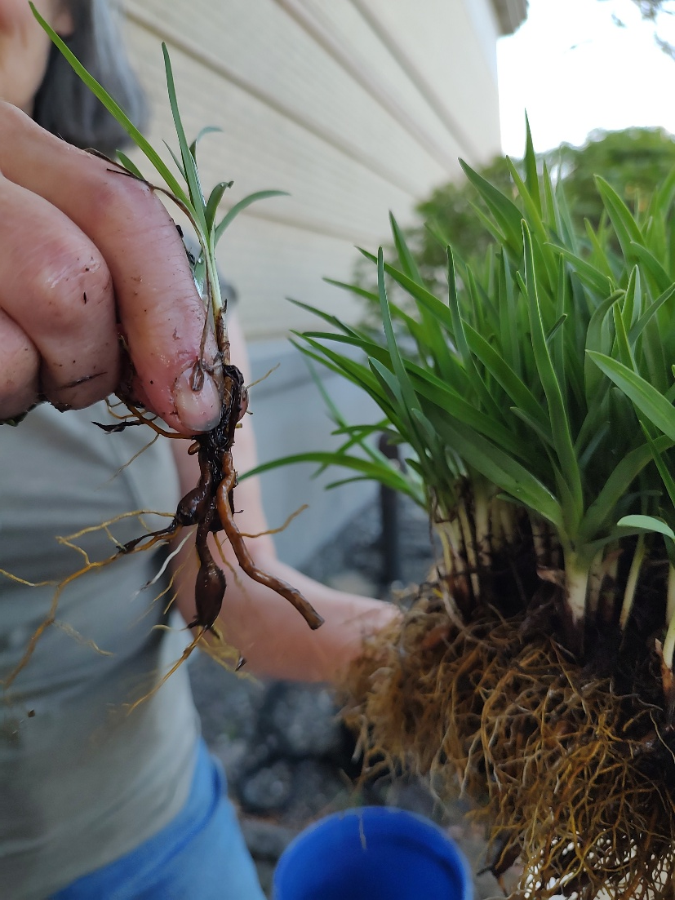
BARE ROOT PLANT PREPARATION
“BARE ROOT” just means a plant without soil. All but the most delicate plants will generally do well like this if you handle them gently, keep them moist and don’t let them sit around for long periods of time. By sharing your plant “bare root” you are decreasing the chances of sharing microscopic pests (like the eggs of the invasive Asian earthworm) and diseases that may linger in the soil. Bare root does not prevent the spread of other diseases/viruses/pests. Your best defense generally is to examine plants carefully and discard any that are questionable.

Slide 2
BEFORE DIGGING
Water plants lightly the night before (this will decrease root stress and allow you to lift it with less damage).
Dig out your plant on a cloudy day or when it’s not in direct sun.
Be prepared to shade the roots so they don’t immediately dry out by covering them lightly or placing in water.

Slide 3
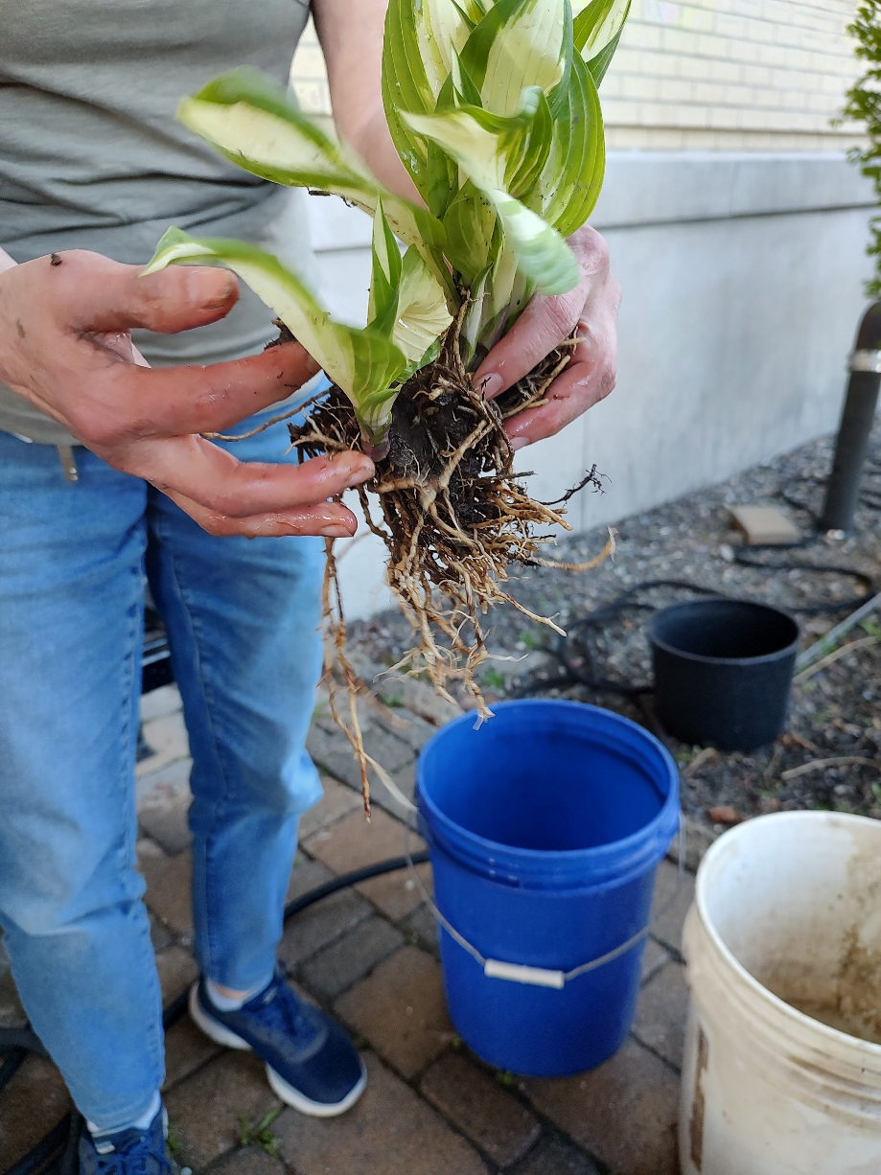
WHEN YOU’VE DUG
Gently knock off as much soil as you can.

Slide 4
“TRIPLE WASH” THEM TO GET THE MOST PROTECTION!!!! ----WHY?
Well, if you’ve ever tried to wash a greasy plastic container, you know that one wash is not necessarily enough. “Triple wash” is a standard for cleaning hazardous substances. It assumes that after three washings you are likely to have removed all nasty residues.
With plants, a triple swish in three separate buckets will most likely remove not only dirt clods and fine particles, but also microscopic fungus, pests and egg casings that you may not be able to see with the naked eye.

Slide 5
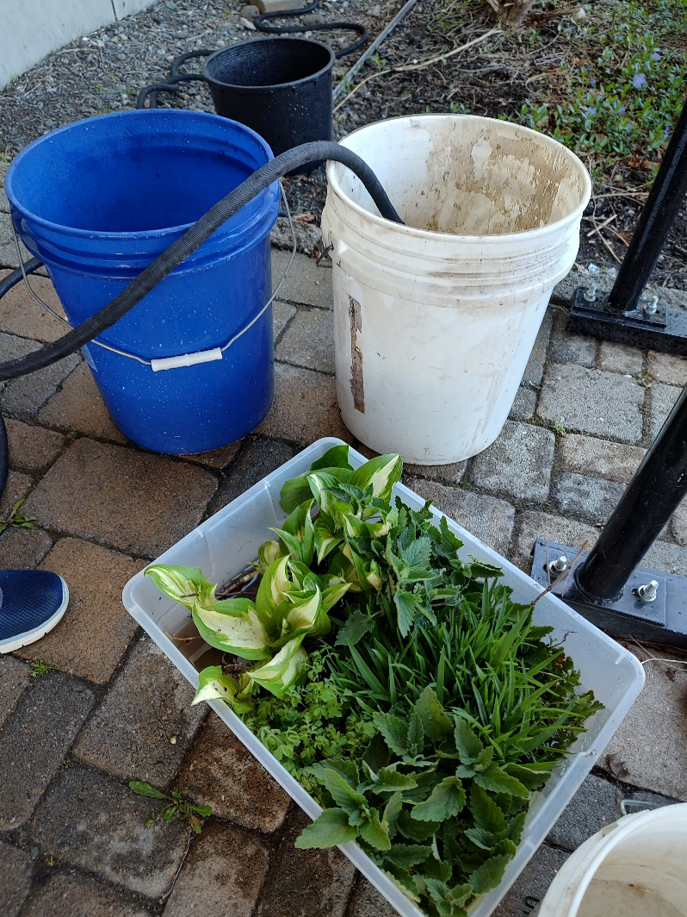
TRIPLE WASH
The easiest way to do this is just to set up three water filled containers and give the plant roots a good swish in each of them. If you are washing several plants from the same area, you can reuse the water as long as you wash in the same order. As you switch areas, make sure to clean out your containers and put in fresh water so you are not contaminating new plants.
Think about where you dispose of your wash water so you are not contaminating new areas!

Slide 6
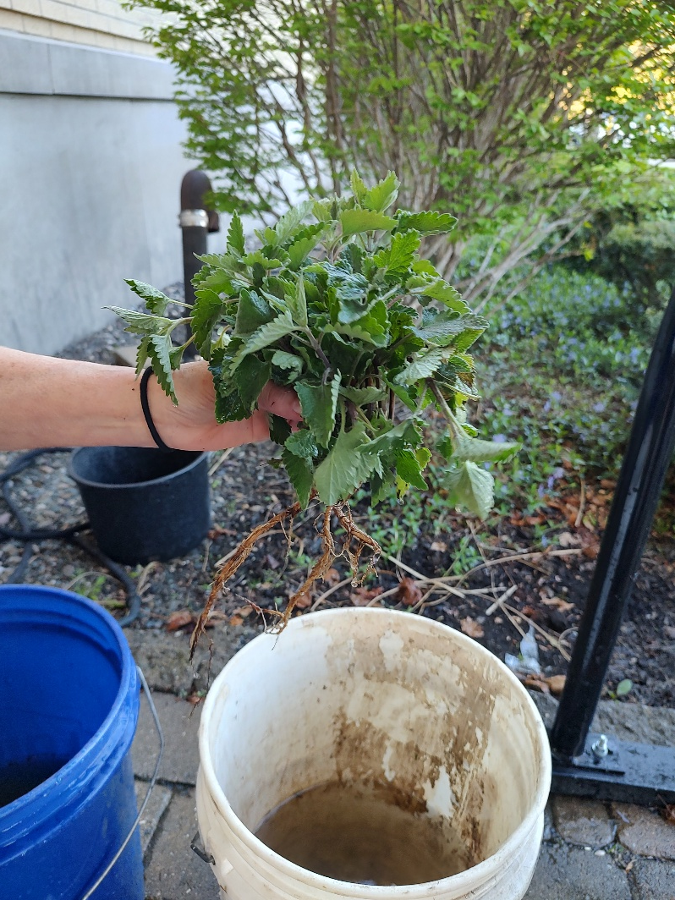
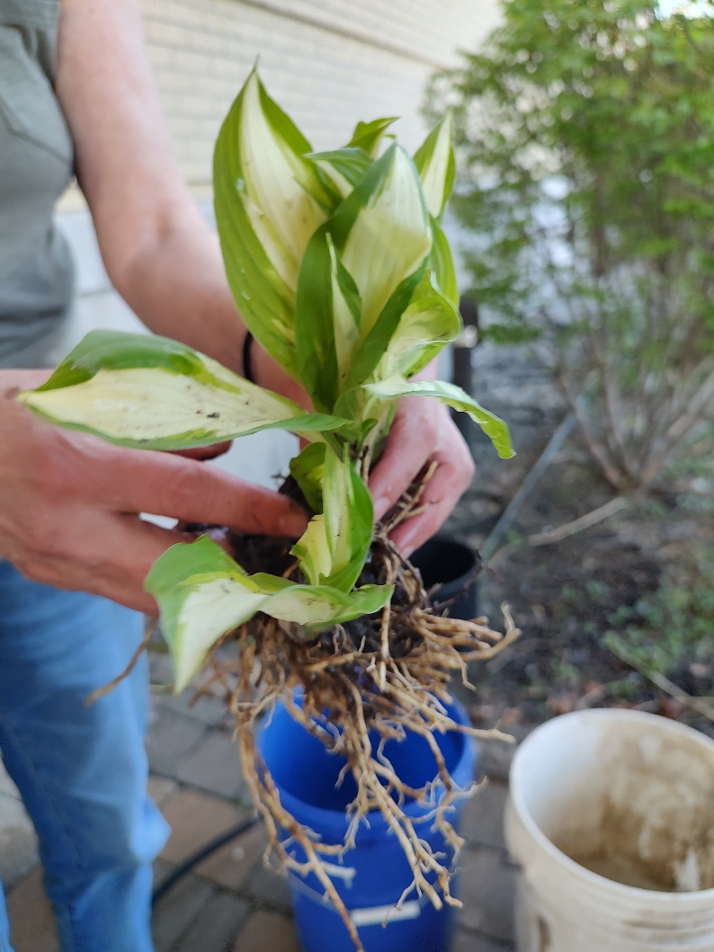
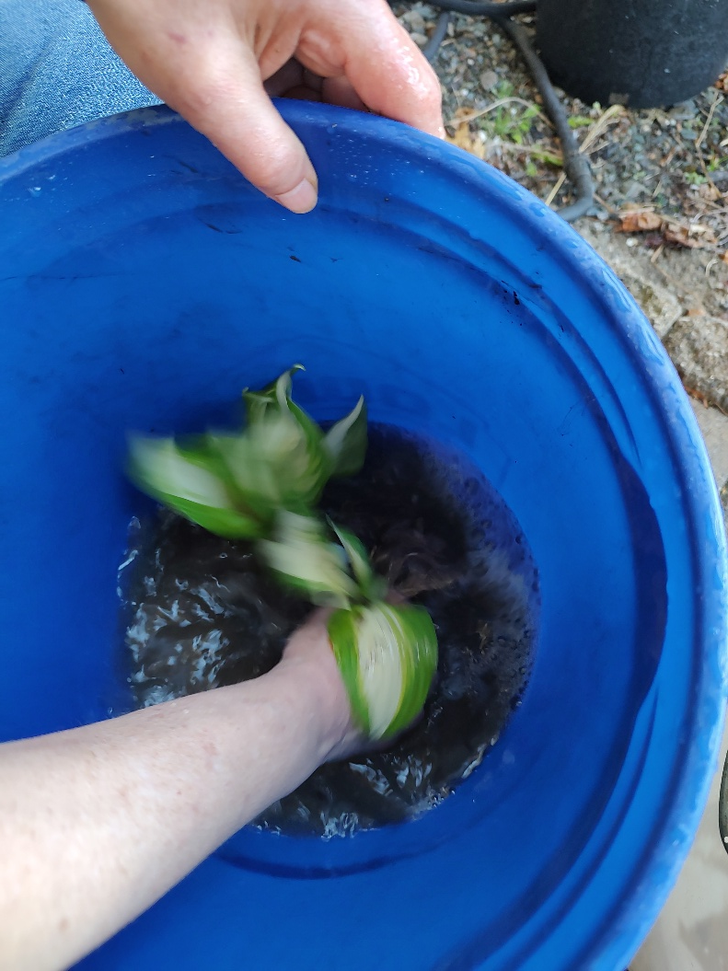
Wash roots clean by gently but thoroughly swishing in plain lukewarm water (not ice cold from the faucet!).

Slide 7
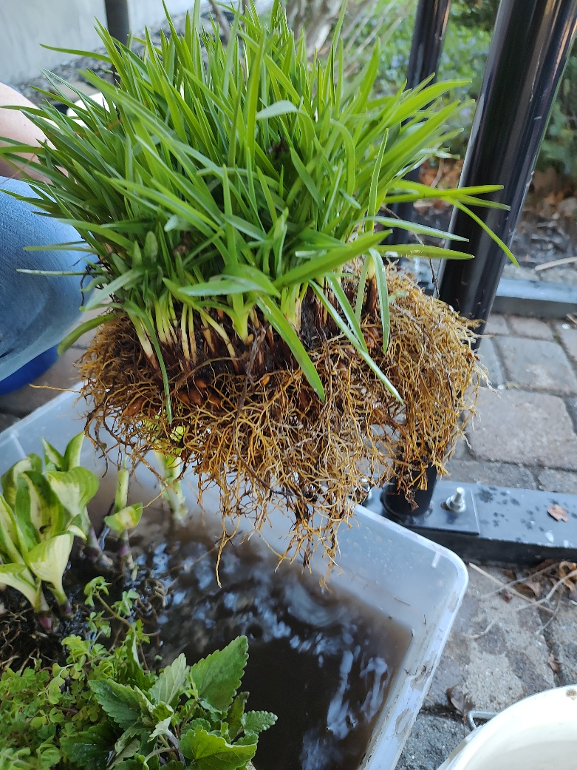
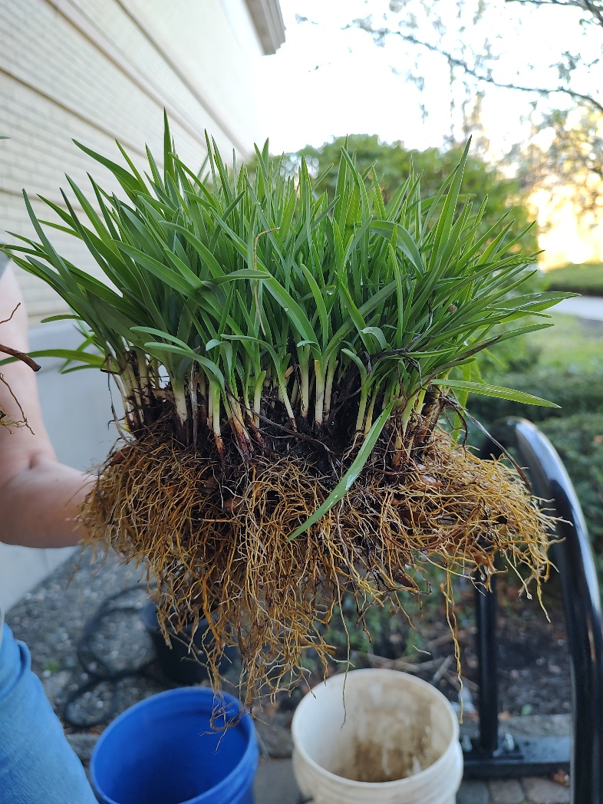


Slide 8
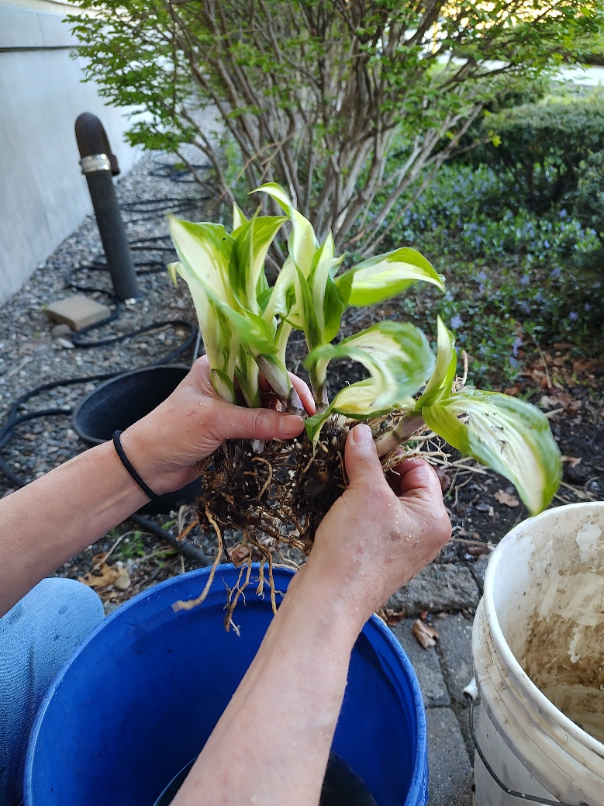
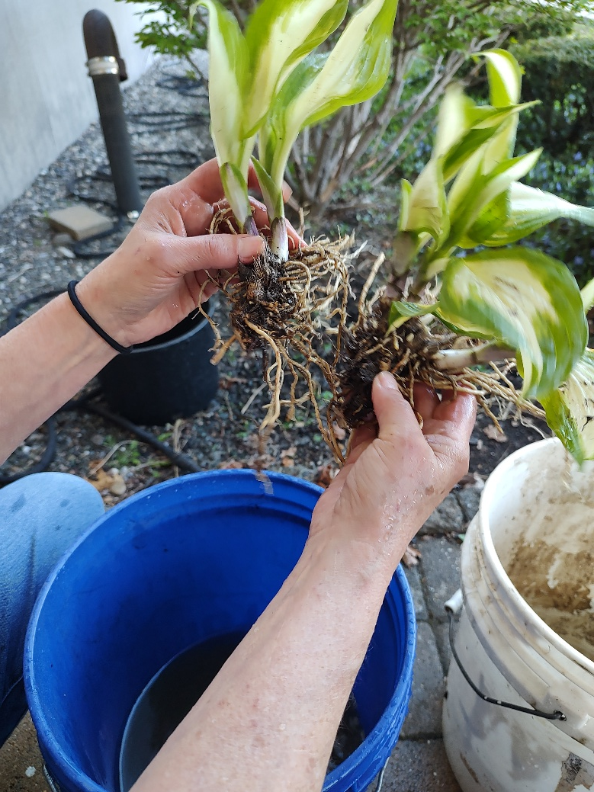
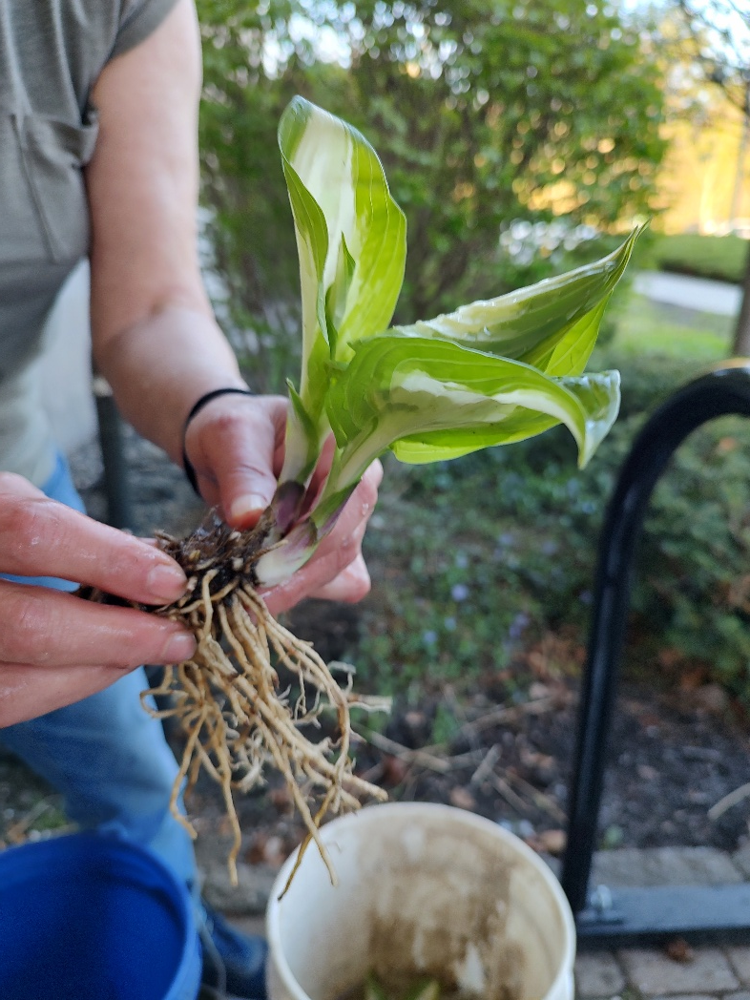
You can divide the plants

Slide 9
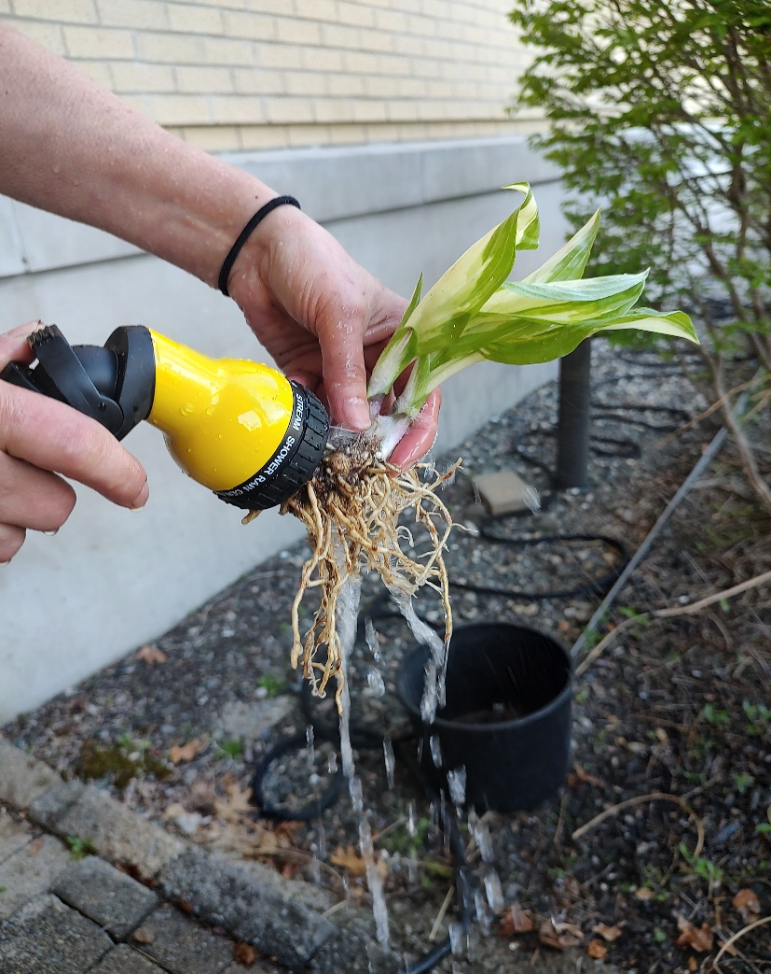
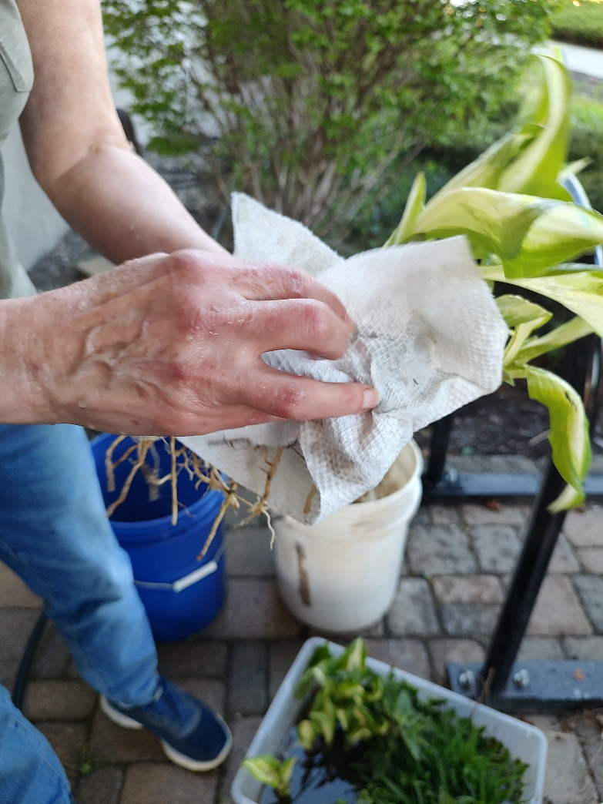
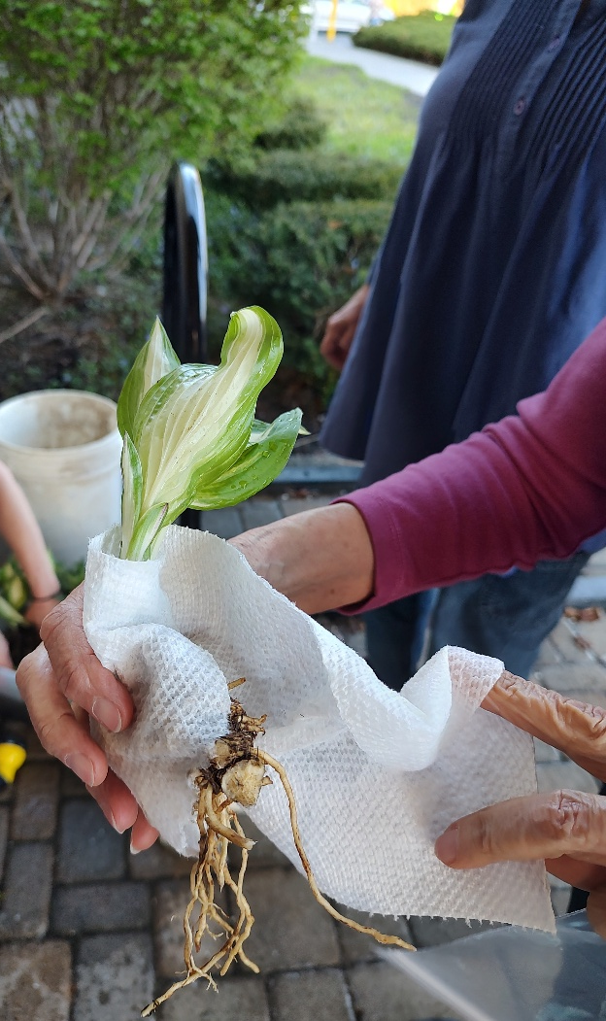

Slide 10
TO STORE AND TRANSPORT
Roots will need to remain moist! You can just put them in enough water to cover. Good containers might be plastic or paper milk containers (easily cut down to size), quart size or smaller yogurt cups, even plastic baggies or recycled newspaper sleeves. Just put in enough water to cover all the roots. Adding some crumpled newspaper or paper towel around the roots to protect and provide shade is a good idea too.
More tuberous roots (iris or daylily) might prefer a good wrapping with newspaper and then just enough water in the container to keep the package moist. But they will survive in plain water as well.

Slide 11
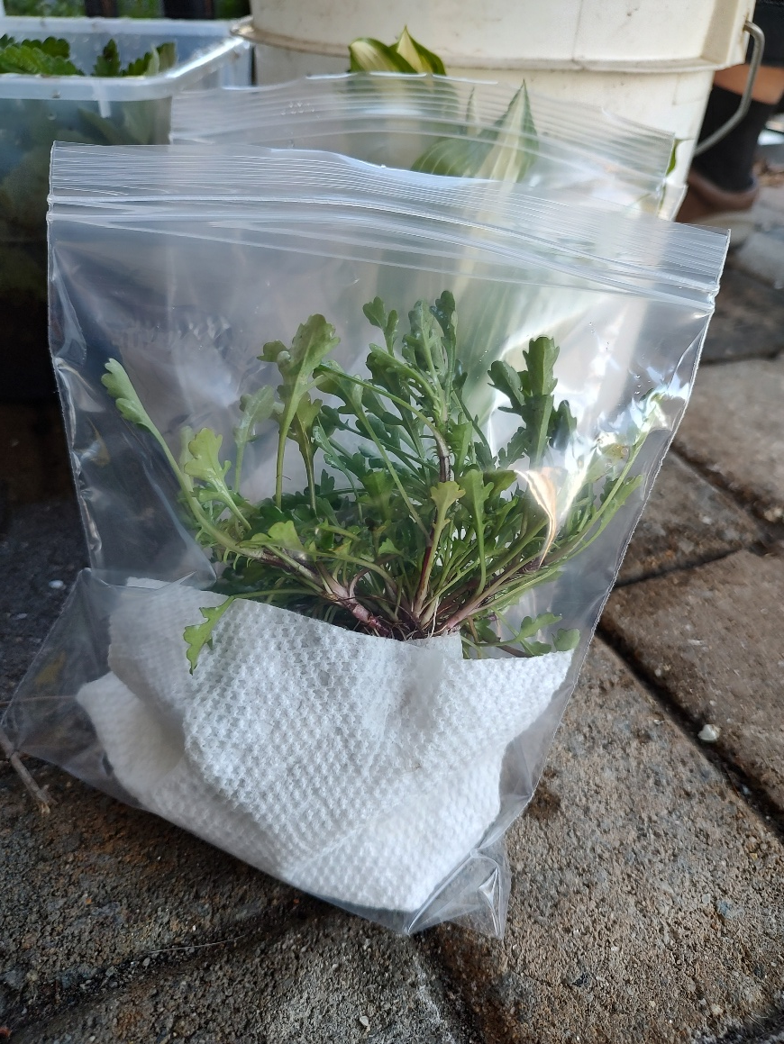
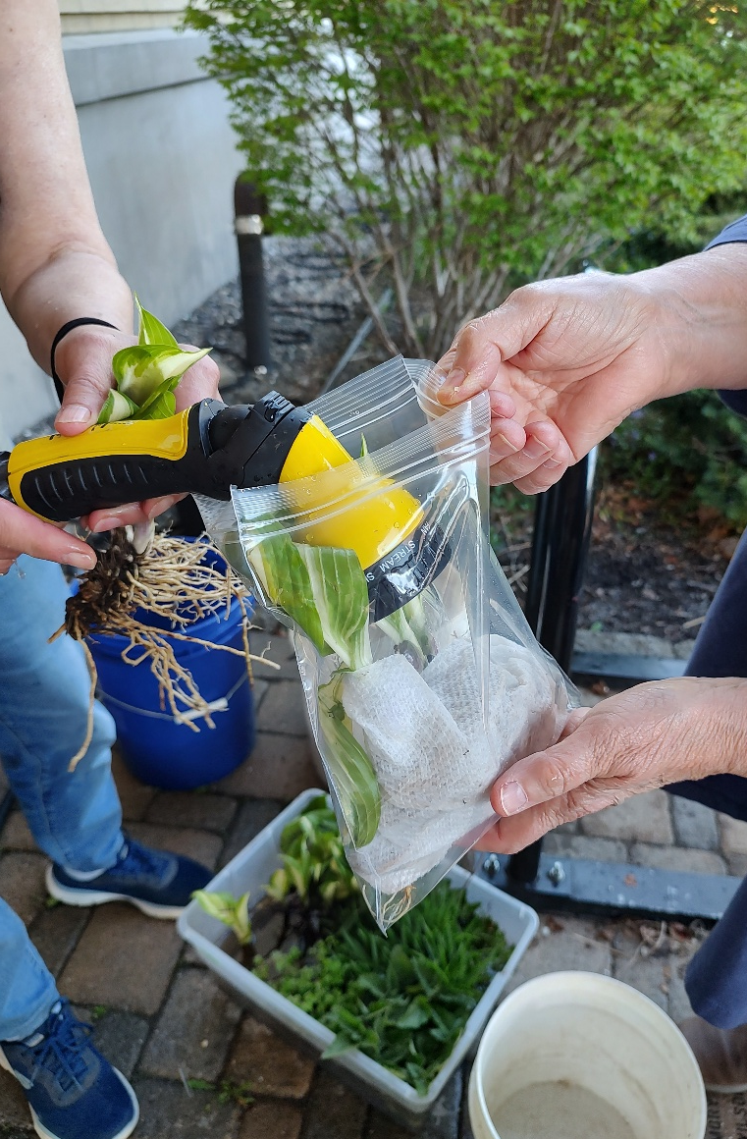
Don’t wrap your roots tightly in plastic as they still need to breathe. Keep any plastic covering loose. Please keep plants out of the direct sun after they are dug!!!

Slide 12
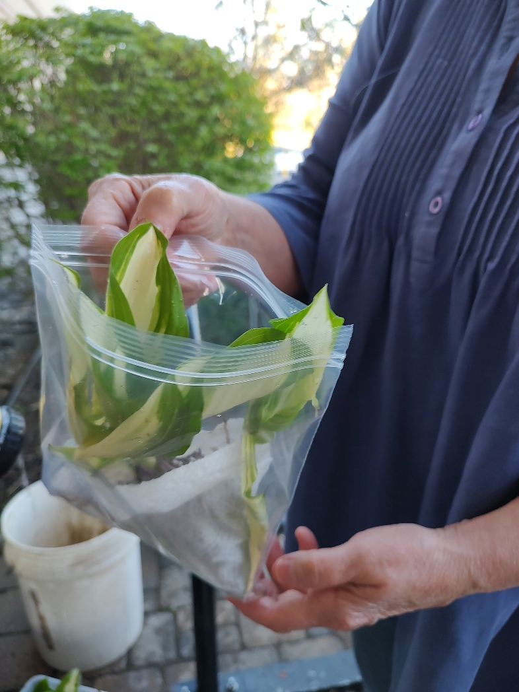
Plants will survive for a week or more without major problems, but keep in mind that “fresher is better” when sharing bare root transplants.

